Slide 1
Basic Window Controls

Slide 2
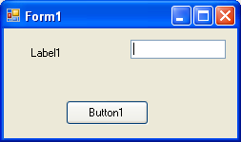
Contents
The Textbox Control
Button Control
Label Control
ListBox Control
CheckedListBox Control
ComboBox Control

Slide 3
Properties and Methods of Controls
To make use of any property or method, we use the dot operator.
  Syntax:
    for setting: nameOfControl.Property=value
    For getting: <variable>=nameOfControl.Property
  Using Methods:
    <variable>=nameOfControl.Method([argument list]
    nameOfControl.Method([argument list])

Slide 4
The Textbox Control
Textbox control is a powerful control that appears in many window Applications.
It can be used for both displaying text to the user that user can edit as well as for entering text.
The control has two basic personalities, depending on how MultiLine Property is set.
  By default, it is set to false, and control can display only single line of text, accepting only 2048 characters.
  When set to true, it can display multiple lines of text. Maximum being 32,000 characters (approx.) We can set WordWrap Property to True/False if we would like to view the text within the area of the textbox.

Slide 5
The Textbox Control: Common Properties
Name : same as naming a variable (Conventional Naming: txtName)
Text: to set/get the text in the box
MaxLength: The maximum number of characters the box can hold
AutoSize: When set to true, the height of the box will adjust automatically to the font size
PasswordChar: set to any single character to be used in place of whatever is entered by the user
ReadOnly: When set to true, the text in the box cannot be modified by the user
TextAlign: we set how the alignment of text within the box. Left by default
TextLength: The length of text in the control
MultiLine: When true the following applies
  ScrollBars: We can add vertical or horizontal scroll bars to the sides of the box
  WordWrap
  Lines – Lines is a string array where each element holds a line of text. The first line of the text is stored in the element Lines(0).
myStr = TextBox1.Lines(0)

Slide 6
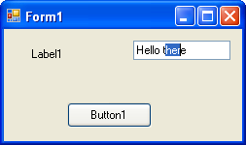
Properties/Methods related to Text Editing
Properties
  SelectionLength: set or get the number of characters selected
  SelectionStart: set or get the position of the first character selected
  SelectedText: set or get the selected text

Slide 7
Properties/Methods related to Text Editing
Methods
  Copy(): Copies selected text to the clipboard
  Cut(): Cuts the selected text to the clipboard
  Paste(): Inserts text from the clipboard to a chosen area
  Select(start_index, length): selects text in a textbox from starting position upto the character such that the selected length = length specified
  SelectAll(): selects the entire text in the textbox

Slide 8
My.Computer.Clipboard Object
The Clipboard can be used to store data, such as text and images.
Because the Clipboard is shared by all active processes, it can be used to transfer data between them.
Items moved or copied to the Clipboard persist even after the application is shut down.
Data on the Clipboard can be in any data format, also called a Clipboard format.

Slide 9
Button Control
This control can be clicked by a user to initiate an action.
  The Click() event is fired and the code to be carried out is placed in the subroutine associated with this event of the control
Name property: set/get name of control
Text property: sets or gets caption of the control
BackgroundImage and Image property: to set an image on the button control. If both were used to set image then what was set by Image property will come on top of the BackgroundImage

Slide 10
Label Control
Used for displaying text not editable by user through the Text Property
It cannot be receive focus but can receive mouse related events
Some other properties
  Name
  Text
  AutoSize
  TextAlign

Slide 11
The ListBox, CheckedListBox and ComboBox Controls

Slide 12
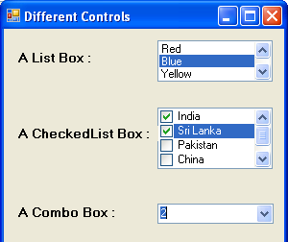
The ListBox, CheckedListBox and ComboBox controls present list of choices from which the user can select one or more.

Slide 13
The ListBox, CheckedListBox and ComboBox Controls
The ListBox control occupies a user-specified amount of space on the form and is populated with a list of items.If the list of items is longer than one can fit on the control, a vertical scroll bar appears automatically.
The CheckedListBox control is a variation of a ListBox control. It displays a list of items, like the ListBox control, but also displays a check mark next to items in the list.
The ComboBox control also contains multiple items but typically occupies less space on the screen. The ComboBox control is an expandable ListBox control i.e. the user can expand it to make a selection and collapse it after the selection is made.

Slide 14
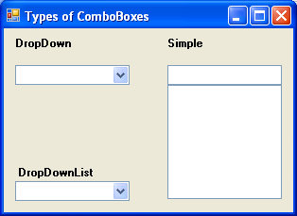
Types of ComboBox Control
There are three types of ComboBox control –
Any of these types can be chosen with the help of the DropDownStyle property of the ComboBox control.

Slide 15
Types of ComboBoxes
Value | Effect
DropDown | (Default) It is a combination of a drop-down list and a text box. An item can be selected from the list or a new one can be typed in the text box.
DropDownList | It is a drop-down list. An item can be selected from the list but a new one cannot be typed in the text box.
Simple | It is a combination of a list and a text box that does not drop down. An item can be selected from the list or a new one can be typed in the text box.

Slide 16
Basic Properties of These control
IntegralHeight – This property is a Boolean value (True/False) that indicates whether the control’s height will be adjusted to avoid the partial display of the last item
Items – The Items property is a collection that holds the items on the control. We use the members of the Items collection to access the control’s items and to add or remove items. Each member of the Items collection is an object.
Sorted – If you want the items to be always sorted, set the control’s sorted property to True.
Applicable to ListBoxes only
  MultiColumn – A ListBox control can display its items in multiple columns, if you set its MultiColumn property to True.
  SelectionMode – This ListBox property determines whether the user can select multiple items and which method will be used for multiple selections. Setting: One/MultiSimple/MultiExtended

Slide 17
SelectionMode Property
When the SelectionMode property is set to SelectionMode.MultiExtended, pressing SHIFT and clicking the mouse or pressing SHIFT and one of the arrow keys (UP ARROW, DOWN ARROW, LEFT ARROW, and RIGHT ARROW) extends the selection from the previously selected item to the current item. Pressing CTRL and clicking the mouse selects or deselects an item in the list.
When the property is set to SelectionMode.MultiSimple, a mouse click or pressing the SPACEBAR selects or deselects an item in the list.

Slide 18
MultiColumn Listbox
A multicolumn ListBox places items into as many columns as are needed to make vertical scrolling unnecessary. The user can use the keyboard to navigate to columns that are not currently visible.
Set the HorizontalScrollbar property to true to display a horizontal scroll bar that enables the user to scroll to columns that are not currently shown in the visible region of the ListBox.
The value of the ColumnWidth property determines the width of each column.

Slide 19
The Items Collection
Add Method:
  Use this methods to add items to the list
  Syntax : ListBox1.Items.Add(item)
  The Add method appends new items to the end of the list, unless the Sorted property has been set to True.
Insert Method:
  Use this method to insert an item at a specific location
  Syntax: ListBox1.Items.Insert(index, item)
  where item is the object to be added and index is the location of the new item.
Clear Method:
  Removes all the items from the control.
  Its syntax is: ListBox1.Items.Clear
Count Method:
  Returns an integer which is the number of items in the list
  Its syntax: <variable>=ListBox1.Items.Count

Slide 20
The Items Collection
Remove Method
  To remove an item from the list
  Syntax is: ListBox1.Items.Remove(item)
RemoveAt Method
  To remove an item from the list based on position
  Syntax is:
  ListBox1.Items.RemoveAt(position)
CopyTo Method
  This method retrieves all the items from a ListBox control and stores them to the array passed to the method as argument.
  Its syntax is:
  ListBox1.Items.CopyTo( arr, index)
  Here arr is the name of an Object array that will accept the items and index is the index of an element in the array where the first item will be stored.

Slide 21
The Items Collection
Contains Method :
  This method accepts an object as argument
  It returns a True/False value indicating whether the collection contains this object or not.
  Its syntax: ListBox1.Items.Contains(item)
  Example:
Dim varItem as String
If Not ListBox1.Items.Contains(varItem) Then ListBox1.Items.Add(varItem)
End If

Slide 22
Other Properties of the ListBox Control
SelectedIndex – Set or get the position of a selected item from the list. First item has index 0 and so on. Last item has index total items – 1. Returns -1 if no item is selected.
  Syntax to use:
    Dim <variable> As Integer=ListboxName.SelectedIndex
SelectedItem – Set or Get a selected item from the list. Returns an empty string(“”) if no item is selected.
  Syntax to use:
    Dim <variable> As Object=ListboxName.SelectedItem

Slide 23
Example
Public Class Form1
Private Sub Form1_Load(ByVal sender As System.Object, ByVal
e As System.EventArgs) Handles MyBase.Load
cmbDropDwn.Items.Add("Apple")
cmbDropDwn.Items.Add("Orange")
cmbDropDwn.Items.Add("Pineapple")
cmbDropDwn.Items.Add("Guava")
End Sub
Private Sub ComboBox2_SelectedIndexChanged(ByVal sender As System.Object,
ByVal e As System.EventArgs) Handles cmbDropDwn.SelectedIndexChanged
MsgBox(cmbDropDwn.SelectedItem & " has index = " &
cmbDropDwn.SelectedIndex)
End Sub
End Class

Slide 24
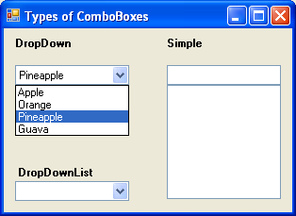
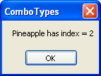
Output

Slide 25
The ScrollBar
&
TrackBar Controls

Slide 26
The ScrollBar & TrackBar Controls
Both these controls let the user specify a magnitude by scrolling a selector between its minimum and maximum values.
The ScrollBar control should be used when the exact value is not as important as the value’s effect on another object or data element.
The Trackbar control has a fixed number of Tick marks, which the developer can label. The user can place the slider’s indicator to the desired value.

Slide 27
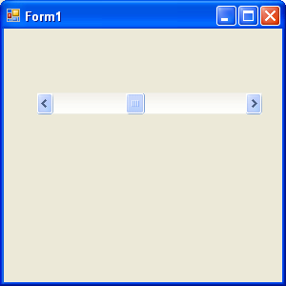
Scrollbar
Note: The Minimum and Maximum properties are positive Integer values. If the range we need is 2.5 to 8.5, we can set the Minimum property to 25 and the Maximum property to 85, and then divide the control’s value by 10.
SmallChange
Value
SmallChange
LargeChange

Slide 28
Basic Properties of a ScrollBar control
Minimum – The control’s minimum value (Default value is 0)
Maximum - The control’s maximum value (Default value is 100)
Value - The control’s current value, specified by the indicator’s position.
SmallChange – The amount by which the scroll box position changes when the user clicks a scroll arrow or presses an arrow key.
LargeChange – The amount by which the scroll box position changes when the user clicks in the scroll bar or presses the Page Up or Page Down key.

Slide 29
Changing the Value of a ScrollBar Control
The user can change the ScrollBar control’s value in three ways:
  By clicking the two arrows at its ends
  By clicking the area between the indicator and the arrows
  By dragging the indicator with the mouse

Slide 30
ScrollBar Events
You can monitor the changes on the scrollBar’s value from within your code with two events: ValueChanged and Scroll. Both the events are fired every time the indicator’s position is changed.
If you change the control’s value from within your code, then only the ValueChanged event will be fired.
The Scroll event can be fired in response to many different actions, such as scrolling of the indicator with the mouse or a click on one of the two buttons at the ends of the scrollbars.

Slide 31
Exercise on ScrollBar
Using functions, write a program to calculate the simple interest accured on a given principal using the formula:
SI = (Principal x rate x Time) / 100
The user input and output thereof must be on different forms. The input form must have a textbox where the principal must be entered by the user, a scroll bar for the rate of interest, and a listbox from where the user can select the time (in years). Provision must also be kept for adding and removing items to and from the listbox.
On clicking a button, the function must calculate the SI and the result should be shown in the second form.
Hint:
Private Sub HScrollBar1_Scroll(… …) Handles HScrollBar1.Scroll
TextBox1.Text = HScrollBar1.Value
End Sub

Slide 32
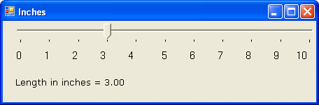
The TrackBar Control
The Basic Properties of a TrackBar control are:
Minimum – The control’s minimum value (Default value is 0)
Maximum – The control’s maximum value (Default value is 100)
Value – The control’s current value, specified by the indicator’s position.
SmallChange – The number of positions the slider moves in response to keyboard input.
LargeChange - The number of positions the slider moves in response to mouse clicks or the PAGE UP and PAGE DOWN keys.
TickFrequency –The number of positions between the tick marks.

Slide 33
Minimum = 0
Maximum = 50
TickFrequency = 5
SmallChange = 1
LargeChange = 5
Private Sub TrackBar1_ValueChanged(ByVal sender As Object, ByVal e As System.EventArgs) Handles TrackBar1.ValueChanged
lblInches.Text = "Length in inches = " & Format(TrackBar1.Value / 5, "#.00")
End Sub

Slide 34
Exercise
Calculate the area of a rectangle where user can simply select length & breadth values from two TrackBar Controls provided. Also provide a CheckBox in the form where user can tick to specify that it is square. If it is a square, the disable breadth trackbar and user needs to select only from length trackbar to calculate the area.
Using two types of Scrollbars(Horizontal and Vertical), design an application to calculate the area of a triangle.
Note**: Any textboxes used for output is to be ReadOnly.

Slide 35
The RadioButton
&
CheckBox Controls

Slide 36
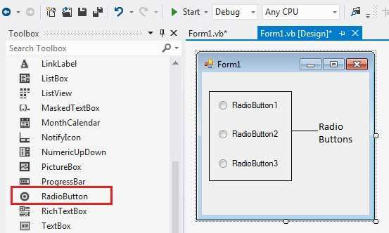
RadioButton Control
The RadioButton control is used to provide a set of mutually exclusive options.
The user can select one radio button in a group. If you need to place more than one group of radio buttons in the same form, you should place them in different container controls like a GroupBox control.

Slide 37
Common Properties of RadioButton
Property | Description
Appearance | Gets or sets a value determining the appearance of the radio button.
AutoCheck | Gets or sets a value indicating whether the Checked value and the appearance of the control automatically change when the control is clicked.
CheckAlign | Gets or sets the location of the check box portion of the radio button.
Checked | Gets or sets a value indicating whether the control is checked.
Text | Gets or sets the caption for a radio button.
TabStop | Gets or sets a value indicating whether a user can give focus to the RadioButton control using the TAB key.

Slide 38
Methods of RadioButton
S.N | Method Name & Description
1 | PerformClick Generates a Click event for the control, simulating a click by a user.
Events of RadioButton
S.N | Event | Description
1 | AppearanceChanged | Occurs when the value of the Appearance property of the RadioButton control is changed.
2 | CheckedChanged | Occurs when the value of the Checked property of the RadioButton control is changed.

Slide 39
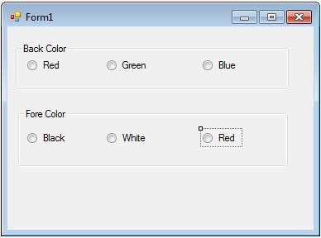
Assignment
Design the following form:
When a user select a color from 1st groupbox, Form’s Backcolor changes. If user selects a color from 2nd groupbox, Form’s ForeColor changes.

Slide 40
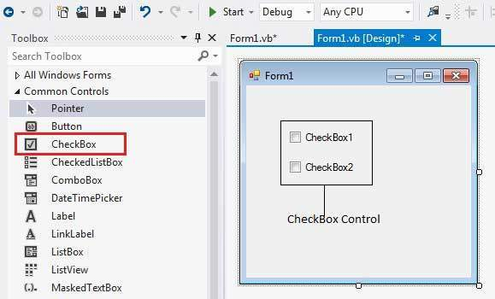
The CheckBox Control
The CheckBox control allows the user to set true/false or yes/no type options. The user can select or deselect it.
When a check box is selected it has the value True, and when it is cleared, it holds the value False.

Slide 41
State of CheckBox Control
The CheckBox control has three states
  Checked
  Unchecked and
  Indeterminate: In the indeterminate state, the check box is grayed out. To enable the indeterminate state, the ThreeState property of the check box is set to be True.

Slide 42
Properties of CheckBox Control
Property | Description
Appearance | Gets or sets a value determining the appearance of the check box.
AutoCheck | Gets or sets a value indicating whether the Checked or CheckedState value and the appearance of the control automatically change when the check box is selected.
CheckAlign | Gets or sets the horizontal and vertical alignment of the check mark on the check box.
Checked | Gets or sets a value indicating whether the check box is selected.
CheckState | Gets or sets the state of a check box.
Text | Gets or sets the caption of a check box.
ThreeState | Gets or sets a value indicating whether or not a check box should allow three check states rather than two.

Slide 43
CheckBox Methods
S.No | Method Name & Description
1 | OnCheckedChanged Raises the CheckedChanged event.
2 | OnCheckStateChanged Raises the CheckStateChanged event.
3 | OnClick Raises the OnClick event.

Slide 44
CheckBox Events
S.No | Event | Description
1 | AppearanceChanged | Occurs when the value of the Appearance property of the check box is changed.
2 | CheckedChanged | Occurs when the value of the Checked property of the CheckBox control is changed.
3 | CheckStateChanged | Occurs when the value of the CheckState property of the CheckBox control is changed.

Slide 45
Thankyou

